Slide 1
MobileHCI 2022 SDC HUAWEI Eyewear Smart Glasses AudioDeviceKit SampleCode
Author: Tang Jingyi, Zhong Chengjun
May 18, 2022

Slide 2
Table of Contents
SampleCode Development Architecture
Development Example Demonstration Description
Q & A

Slide 3
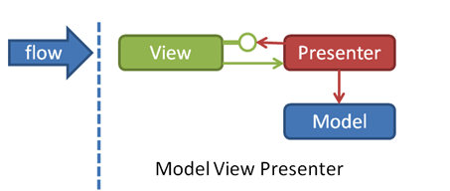
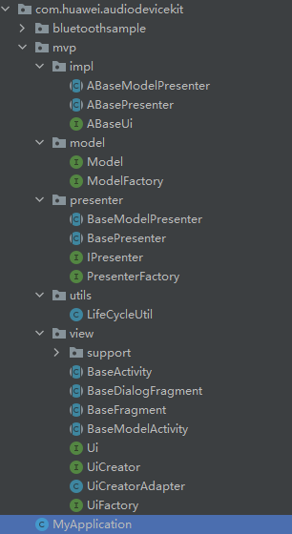
Smart glasses development architecture
The SampleCode project is built under the Model-View-Presenter (MVP) architecture.
The SampleCode project provides the base classes of the MVP architecture.
FYI
Model and View interact only through Presenter, and View interact with Presenter through interfaces.
View is an activity, which focuses on the object and result of the operation.
Model is the service logic and focuses on the implementation of core service functions.

Slide 4
Sample Demo - Initialization
Initialization/Deinitialization
All operations on glasses, including device discovery and device connection, depend on the successful SDK initialization.
The developer needs to invoke the initialization interface e.g. MainActivity->onCreate() before performing the corresponding operation.
Developers are advised to deregister the SDK during the application and GUI destruction process. e.g. MainActivity->onDestroy()
Initialization example:
AudioBluetoothApi.getInstance().init(context, new IInitResultCallBack() {
@Override
public void onResult(boolean result){}
@Override
public void onFinish() {{//Action after successful initialization}
});
Example of deinitialization:
AudioBluetoothApi.getInstance().deInit();

Slide 5
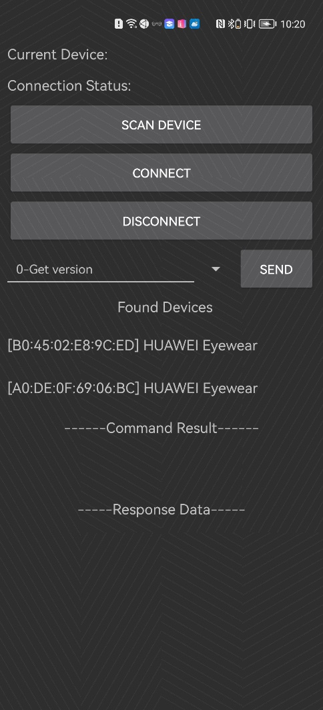
Example Demo - Finding Eyewear Devices
Click Scan Device to invoke the search API to search for devices.
It is recommended that you call the StopSearch API before the SearchDevice to prevent the last search from being completed.
After the device is found, the device name and Bluetooth Mac address will be displayed under Found Device.
Related APIs are as follows:
Stop lookup:
AudioBluetoothApi.getInstance().stopSearch();
Start looking:
AudioBluetoothApi.getInstance().searchDevice(DiscoveryHelper.FoundCallback);

Slide 6
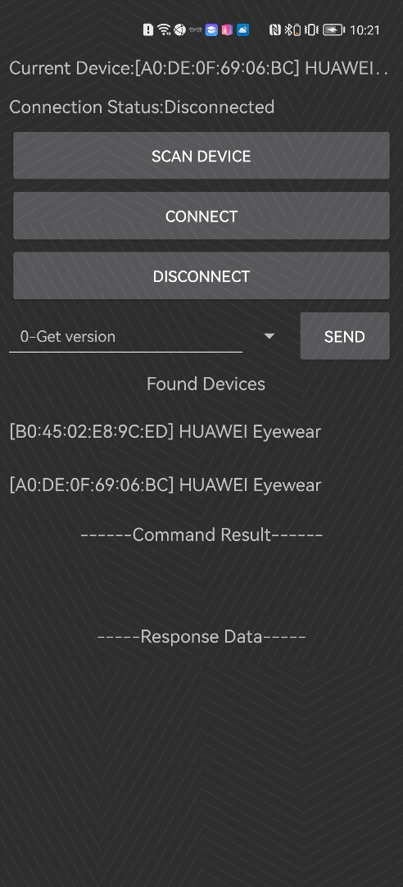
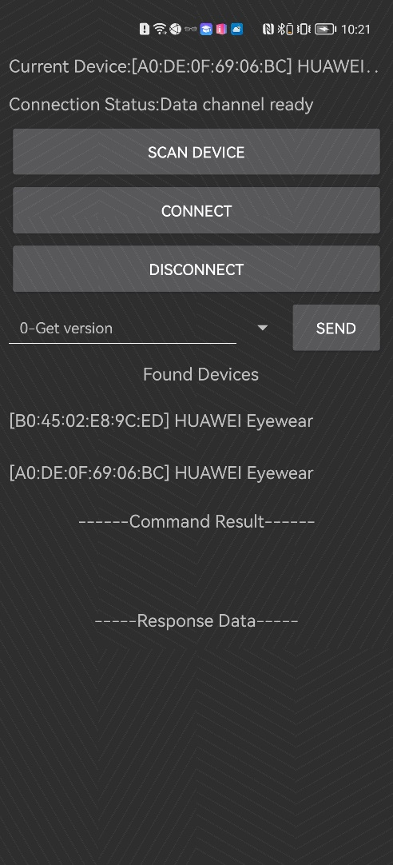
Example Demo - Connecting/Disconnecting Devices
Click an item in the device list to connect to the device.
The connection status displays “Data Channel Ready".
After the connection is successful, click the device list or click the disconnect button. The device will be disconnected. The Connection Status will be Disconnected.
To connect to the device again, click the item under device list or click the Connect button to connect to the device again.
When the connection is successful
It is recommended to register the data reporting listener to listen to the commands reported/replied by the device.
It is recommended to unregister the data reporting listener when disconnected.
Related APIs are as follows:
To query the device connection status, run the following command:
AudioBluetoothApi.getInstance().isConnected(mac);
Connected equipment:
AudioBluetoothApi.getInstance().connect(mac, ConnectStateListener);
Disconnected equipment:
AudioBluetoothApi.getInstance().disconnect(mac, ConnectStateListener);
Registration data reporting listening:
AudioBluetoothApi.getInstance().registerListener(mac, INotifyListener);
Deregistration data reporting listening:
AudioBluetoothApi.getInstance().unregisterListener(mac);

Slide 7
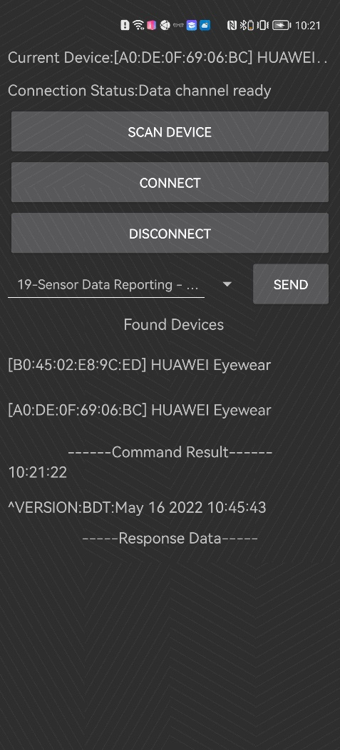
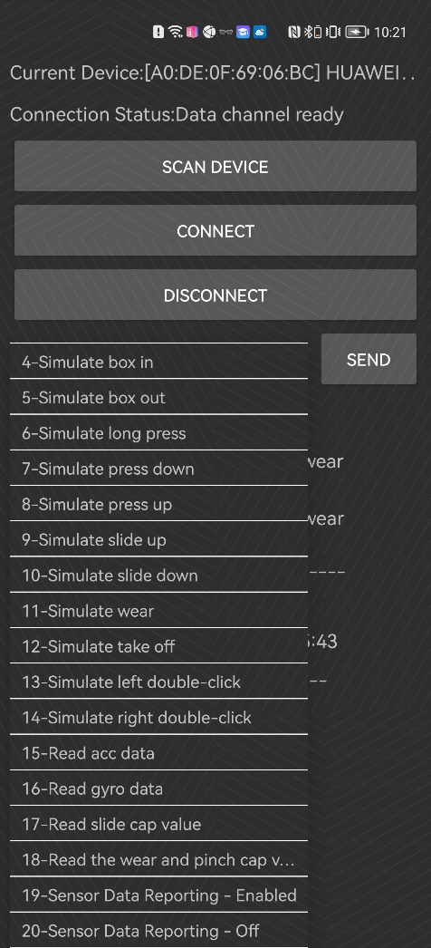
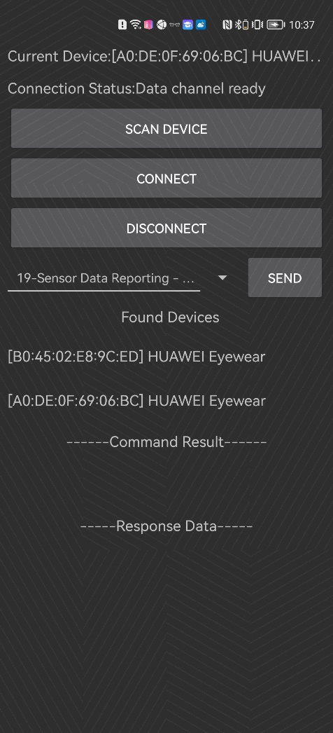
Example Demo - Sending Commands
After selecting the command to be sent, click the Send button to send the selected instruction to the glasses side. The result data returned by the glasses will be displayed below the Command Result.
Related APIs:
Send commands:
AudioBluetoothApi.getInstance().sendCmd(mac, cmdType, IRspListener);
Commands type (Enum):
CmdType{
VERSION: Query the version number.
.... ,
SENSOR_DATA_UPLOAD_OPEN: Enables sensor data reporting.
SENSOR_DATA_UPLOAD_CLOSE Disables sensor data reporting.
}

Slide 8
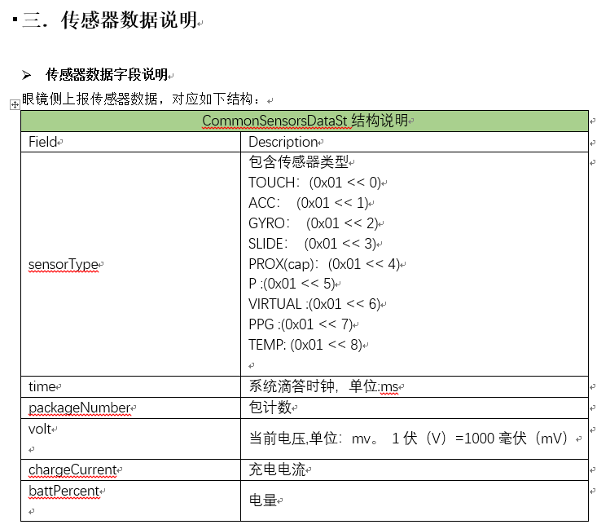
Sample Demo - Receive Commands
The glasses send commands to the app in either of the following cases:
After receiving the query command from the app, the glasses return the result of the query.
When the glasses sensor data changes and the sensor data reporting switch is turned on, the real-time sensor data will be reported.
The raw data reported by the glasses is a binary byte array, which can be parsed into a SensorData data entity class by using the following API method:
SensorData sensorData = SensorDataHelper.genSensorData(appData);
For details about the SensorData data entity class, see section 3 "Sensor Data Description" in the Evain Innovation Competition SDK Guide.docx.

Slide 9
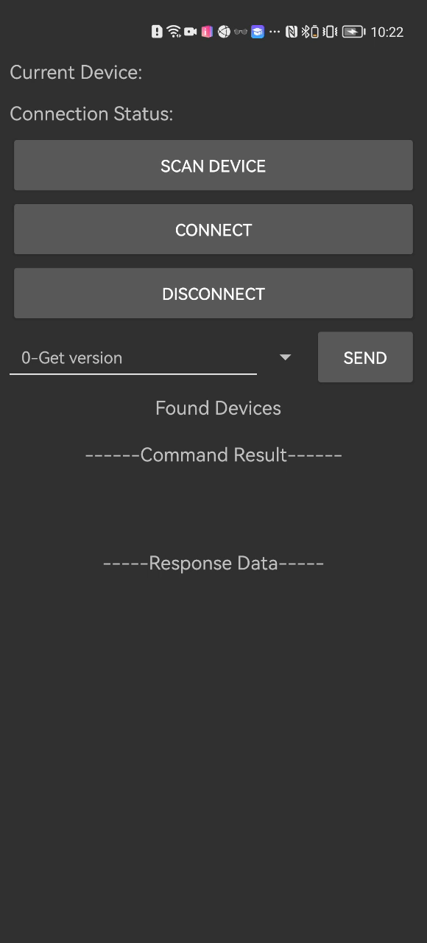
Sample Demonstration - Sample App Operation Video Demonstration

Slide 10
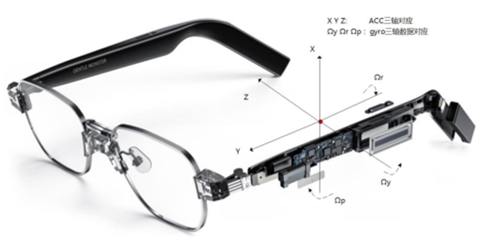
Q & A

